Slide 1
MyBaby4Me
Initiative Implementation Playbook

Slide 2
Contents
  Instructions
  Stage goals and timeline
  Background
  Scope
  Reporting lines
  RACI assignments
  Stage 1 — Identify and select location
  Stage 2 — Approvals
  Stage 3 — Build the team
  Stage 4 — Marketing and communications integration
  Stage 5 — Program kickoff and launch
  Stage 6 — Operational compliance and sustainability
  Glossary
  Appendices

Slide 3
Instructions
How to use this playbook
  This playbook will help stakeholders understand the expectations and deliverables for implementing the MyBaby4Me initiative.
  This playbook consists of six stages, each with a description, required steps, action items, and outcomes.
  The stages are sequential to keep consistency and order.
  If the schedule of steps needs to be adapted for local needs, the proposed changes need to be approved by the area MyBaby4Me council.
  Updates will be based on MEAL reports.

Slide 4
Stage Goals and Timeline
Stage 1 (2-3 Months)
Identify and select location
Stage 2 (2-3 Months)
Approvals
Stage 3 (1 Month)
Build the team
Stage 6 (18 Months)
Operational compliance and sustainability
Stage 5 (1 Month)
Program kickoff and launch
Stage 4 (2 Months)
Marketing and communications integration
Time frames are estimates only and can take place concurrently

Slide 5
  Background
  During the past 50 years, the infant mortality rate (the number of children who die before one year of age, per 1,000 births) in the United States has not improved on pace with other countries participating in the Organization for Economic Co-operation and Development (OECD). In 2021, the average infant mortality rate among OECD countries was 4.2. The United States ranked number 37, at 5.4. Some states with the highest infant mortality rates are located within the North America Southeast Area.
  In the United States, mortality for black infants is 2 to 3 times higher than for non-Hispanic white infants, and maternal mortality ranges from 2.5 to 3 times higher for black women than non-Hispanic white women. These racial disparities are often localized to communities where residents live in poverty.
  MyBaby4Me empowers participants to advocate for themselves more effectively; addresses social determinants of health like housing stability and nutrition; facilitates access to medical care and community programs; and fosters a sense of belonging, hope, and belief in a safe and loving environment.
  Various hospital and public health-based programs have been introduced to try to reduce racial disparities and unacceptable mortality rates but to date have been largely unsuccessful. MyBaby4Me is based on peer- reviewed research at Ohio State University with a proven record of diminishing infant mortality.¹
    ¹Gabbe PT, Reno R, Clutter C, Schottke TF, Price T, Calhoun K, Sager J, Lynch CD. Improving Maternal and Infant Child Health Outcomes with Community-Based Pregnancy Support Groups: Outcomes from Moms2B Ohio. Matern Child Health J. 2017 May;21(5):1130-1138. doi: 10.1007/s10995-016-2211-x. PMID: 28074311

Slide 6
Scope
  MyBaby4Me is a zip code-based intervention initiative developed by the North America Southeast Area of The Church of Jesus Christ of Latter-day Saints. It is administered, operated, and implemented through a national banner organization in collaboration with local banner organizations. The objective of the initiative is to reduce infant mortality rates in underserved communities and to set families on a path out of generational poverty.
  The initiative only offers support to women who are soon-to-be mothers or new mothers with infants up to 18 months old, residing in specific zip codes identified as being at risk for increased mortality. The initiative addresses gaps in community health care and provides access to some essential resources.
  Participants can get help with housing and food insecurity, transportation, health care sourcing, early and prenatal education, GED completion, and job searching. Weekly educational classes provide information about maternal and infant health and help to support and inspire mothers in an environment of love, hope, and safety.
  Volunteers and staff do not practice medicine. Volunteers and staff refer participants to discuss specific health needs with their medical doctor. Participants are encouraged to dial 911 if they have a medical emergency.
  Each implementation is funded for the first 18 months after executive approvals. After 18 months, the national banner organization should be capable to run the initiative by other donor funding.
  The national banner organization is responsible for managing the implementation and administers the initiative. This includes anything related to finances, data collection, advertising, compliance with necessary agreements and policies, fiscal sustainability after the initial seed funding, employment liability and insurance, and all operational matters.
  The national banner organization recruits, coordinates, and supervises non-Church members, volunteers, and personnel involved in the program.
  Church members and full-time missionaries are recruited by area welfare/self-reliance services staff with assistance from the area consultant.

Slide 7
Reporting lines
National Banner
Primary contact for budget, data, program administration, and operational issues
Primary contact for national banner assets (such as promotional materials, flyers, and supplies)
Primary contact for local banner organization
MOU/agreements with the Church and the local banner organization
Financial support to local banner organization
Budget development and allocation
Data management
Procurement of meals/food, groceries, gift cards (as requested by coordinators and allowed by budget)
Transportation budget
Guideline interpretation and exceptions
Grant writing and coordination (in collaboration with the Church)
Area Consultant
Primary contact point for senior missionary MyBaby4Me coordinators
Curriculum questions
Missionary transportation responsibilities (non-budget related)

Slide 8
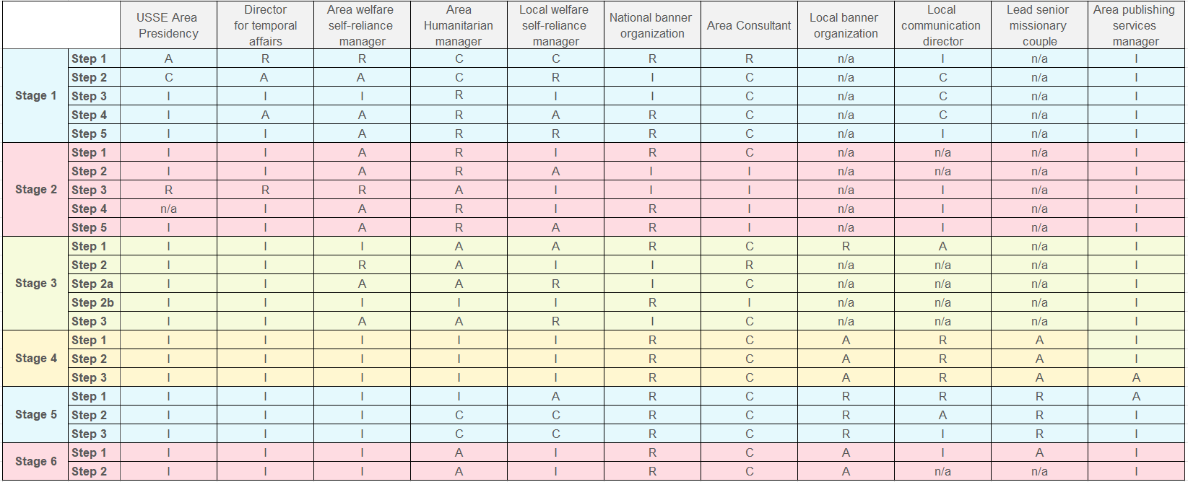
RACI assignments
R = Responsible A = Accountable C = Consulted I = Informed

Slide 9
Stage 1
Identify and select location
1
Identify
Documents
Team
Marketing
Launch
Sustain
Appendices

Slide 10
The three key outputs of this stage will be:
Identify target cities/zip codes/neighborhoods
Confirm stake and community stakeholders
Lock local banner organization
Step 1: Identify potential location
Step 2: Confirm stake(s) capacity and willingness
Step 3: Confirm community support
Step 4: Identify potential local banner organizations
Step 5: Meet preferred local banner and potential support organizations

Slide 11
Identify
Step 1
  Identify potential location
  With the direction/approval of the Area Presidency, the area consultant and national banner organization and AWSRM work together to identify the zip code within a city where the initiative can be most effective.
  Action items
  Identify underserved community by:
    Child mortality statistics
    Zip codes or neighborhoods
    Current initiatives in the perimeter
    Local government/community endorsement
  Outcome
    Identification of target cities/zip codes/neighborhoods
Step 2
  Confirm stake(s) capacity and willingness
  Welfare/self-reliance manager verifies stake capacity to provide volunteers.
  Action items
    Seek Area Seventy's recommendation and stake president(s) commitment to provide support personnel (appendix 1)
    Evaluate capability of providing one stake-level coordinator and four to six young and senior service missionaries, and/or support personnel who can serve for two years twice a week for about three hours each day for the following and possibly other activities:
      Childcare support
      Meal preparation, serving, and cleanup
    Present MyBaby4Me service opportunity for stake members
  Outcome
    Confirmation of stake(s) support

Slide 12
Identity
Step 3
  Confirm community support
  Area humanitarian manager delegates responsibilities to the area consultant as needed to seek community support for MyBaby4Me initiative in a targeted zip code.
  Action items
    Lobby initiative
    Present initiative concept to community stakeholders and confirm interest
  Outcome
  Community is receptive and willing to support the initiative
Step 4
  Identify potential local banner organizations
  National banner organization and area humanitarian manager search for a local banner organization within the identified zip code/neighborhoods.
  Action items
  Identify organizations that have:
    Reputation for service in the community
    Credibility with community
    Background and experience in providing services to women and children
    Credibility with local business and government
    IRS designation as 501(c)(3) (appendix 3)
  Outcome
    List of potential local banner organizations

Slide 13
Identity
Step 5
  Meet preferred local banner and potential support organizations
  The national banner organization, area humanitarian manager, and local self-reliance manager meet with potential local banner organizations to introduce the initiative. Outline the history and purpose, audience, curriculum, and operational plan. If a banner organization demonstrates interest, the Area MyBaby4Me council/national banner organization will consider their qualifications and decide whether to move forward with them.
  Action items
    Meet with potential local banner/support organizations
    Present the local community executive summary and MyBaby4Me one-page summary (appendix 2)
    Verify that the organization clearly understands the initiative's goals and the organization’s role
    as the local banner collaborating organization (appendix 3)
    Discuss miscellaneous needed commodities (appendix 4)
    Discuss essential relationships (appendix 5)
    Discuss child entertainment tools (appendix 6)
    Discuss guidelines for volunteers and organizations (appendix 7)
    Discuss MyBaby4Me guidelines for mothers (appendix 8)
  Outcome
    Local banner organization is selected

Slide 14
Stage 2
Approvals
1
Identify
2
Approvals
Team
Marketing
Launch
Sustain
Appendices

Slide 15
The three key outputs of this stage will be:
Approval to move forward
All contracts reviewed and signed
Funding dispersed
Step 1: Proposal submission
Step 2: Internal administrative arrangements
Step 3: Approval
Step 4: Sign contracts
Step 5: Transfer funds

Slide 16
Approvals
Step 1
  Proposal submission
  The national banner organization prepares a proposal
  for an 18-month budget for the MyBaby4Me initiative, for the selected zip code, and submits it to the area humanitarian manager.
  Action items
  Presentation includes:
    Detailed budget distribution
    Budget administration tools
    Measurable outcomes
    Monitoring and evaluation plan
    Sustainability plan
    Number of beneficiaries
    Proposed start date
    Data collection process
  Outcome
    Project proposal for review
Step 2
  Internal administrative arrangements
  The area humanitarian manager arranges for proper control, funding, and internal project management.
  Action items
    Enter project proposal in ChaS
    Obtain project approval from the Area Presidency
  Outcome
    Project approved and entered to ChaS

Slide 17
Approvals
Step 3
  Approval
  Area welfare/self-reliance manager and director of temporal affairs presents the proposal to the Area Presidency with an update on MyBaby4Me implementation.
  Based on funding levels, other executive councils will need to approve.
  Action items
    Executive presentation
      Background
      Current situation
      Proposed intervention
      Measurable outcomes
      Budget
  Outcome
    Approval to move forward
Step 4
  Sign contracts
  Area humanitarian manager verifies master service agreement terms and negotiates contract with national banner organization.
  Action items
  Contracts between the Church and national banner organization
    Review master service agreement
    Create work order for new location
    Contract between national banner and local banner organization
    Liability and IP disclosures
    Facilities usage
  Outcome
    All contracts reviewed and signed

Slide 18
Approvals
Step 5
  Transfer funds
  Area humanitarian manager disperses funds to national banner organization for project implementation.
  Action items
    Disburse project funds to the national banner organization
    National banner organization disperses funds to local banner organization
      Monthly dispersion/as needed
    Local or national banner organization procures items and commodities needed for operation (appendix 4)
  Outcome
    Funding dispersed

Slide 19
Stage 3
Build the team
1
Identify
2
Documents
3
Team
Marketing
Launch
Sustain
Appendices

Slide 20
The five key outputs of this stage (depending on availability of a
senior missionary couple) will be:
Begin implementation process
Identify full-time missionary couple and assign them to serve in the MyBaby4Me initiative
Make sure that local priesthood leadership is aware of and committed to supporting the initiative
Hire national banner employee
Step 1: Assemble team
Step 2: Recruit and orient full-time missionary couples
Step 2a: Recruit and train local young and senior MyBaby4Me service missionaries and support personnel
Step 2b: Recruit and train full-time national banner employee
Step 3: Recruit and orient local young and senior service missionaries and support personnel

Slide 21
Team
Step 1
  Assemble team
  Assemble the national banner and local banner organizations.
  Action items
  Assemble local implementation team
    Local banner organization
    Area humanitarian manager; communications and stake leadership (as determined by stake president)
    National banner
    Local collaborating organizations:
      Academic medical center(s)
      Public health department(s)
      Local private hospitals
      Local doula support
      Lactation consultant
      Other interested community members
      Churches
  Present the community presentation (appendix 9)
  Checklists and forms to support initiative implementation
    Executive summary and MyBaby4Me one-page summary (appendix 2)
    Local banner criteria checklist (appendix 3)
    Essential relationships checklist (appendix 4)
    Miscellaneous commodities checklist (appendix 5)
    Child entertainment tools checklist (appendix 6)
    MyBaby4Me guidelines for volunteers and organizations (appendix 7)
    MyBaby4Me guidelines for mothers (appendix 8)
    Full-time missionary couple checklist (appendix 10)
    Marketing/communications plan (appendix 11)
    Signage checklist (appendix 12)
    Program schedule (appendix 13)
    Release of information and transportation waiver forms (appendix 14)
    Sustainable funding sources (appendix 15)
  Outcome
    National banner begins implementation process with virtual meetings approximately 12 weeks before the first class (appendix 16)
    National banner plans press conference and neighborhood canvas to occur 3-4 weeks before first launch

Slide 22
Team
Step 2
  Recruit and orient full-time missionary couples
  Area consultant identifies candidates who are interested in serving as infant mortality reduction team members.
  Action items
    Potential infant mortality care specialist missionary couples are identified through the senior missionary website and on referral
    from current missionaries
    Communicate with potential missionary couples
    Couples submit applications through the senior missionary portal, requesting assignment to the MyBaby4Me initiative (appendix 10)
    Verify that they are assigned to that calling
    Help full-time missionary couples become familiar with the
    approved curriculum (appendix 13)
  Outcome
    Full-time missionary couple identified and assigned to serve in the MyBaby4Me initiative

Slide 23
Team
Option 2a
(Alternative if no full-time senior missionary support)
  Recruit and train local young and senior MyBaby4Me service missionaries and support personnel
  The area humanitarian manager organization identifies candidates who can serve as MyBaby4Me support specialists to support the local initiative.
  Action items
    Acquaint local priesthood leaders with the MyBaby4Me curriculum and structure, using executive summary for stake leadership (Appendix 1). Indicate that the local senior service missionaries will assume the care role previously supported by the full-time couple
    A minimum of six members are called as senior service missionaries with increased responsibility to love and nurture the women and children they serve. These senior service missionaries coordinate their activities and time commitment to meet program needs
    Young service missionaries are assigned to help with the initiative but cannot be assigned to childcare
    Other support specialists can be assigned and volunteers solicited
  Outcome
    Local priesthood leadership provides adequate support for successful operation of the initiative
Option 2b
(Alternative if no full-time senior missionary and no local young and senior missionary support)
  Recruit and train full-time national banner employee
  The national banner organization identifies candidates who are interested in serving as infant mortality reduction team members.
  Action items
    Full-time national banner employee is identified and
    hired to manage MyBaby4Me at the selected site
    Employee studies the MyBaby4Me guidelines for mothers
    (Appendix 7) and MyBaby4Me guidelines for volunteers and organizations (Appendix 8)
    Employee becomes familiar with the approved curriculum (Appendix 13)
    Employee communicates with potential service missionaries
  Outcome
    Full-time national banner employee is identified, hired, and
    assigned to manage the local MyBaby4Me operation

Slide 24
Team
Step 3
  Recruit and orient local young and senior service missionaries and support personnel
  The welfare/self-reliance manager identifies candidates who can serve as MyBaby4Me support specialists to support the local initiative.
  Action items
    Acquaint local priesthood leaders with the MyBaby4Me curriculum and structure, using the executive summary for priesthood leadership (appendix 1)
    Members are called as senior service missionaries
    Young service missionaries are assigned to help with the initiative but cannot be assigned to childcare
    Additional support specialists can be assigned and volunteers solicited
    Outcome
    Local priesthood leadership is aware of and committed to providing
    adequate missionary support

Slide 25
Stage 4
Marketing and
communications integration
1
Identify
2
Documents
3
Team
4
Marketing
Launch
Sustain
Appendices

Slide 26
The three key outputs of this stage will be:
Marketing plan in place, leading to opening date
Materials printed and ready for distribution
Community awareness through targeted invitations
Step 1: Marketing/communication plan
Step 2: Public information materials
Step 3: Marketing plan implemented, scheduled, and ready for launch

Slide 27
Marketing
Step 1
  Marketing/communication plan
  National Banner organization and local Communication director
  Action items
    Localize graphics, signage, and props
      Create specific neighborhood awareness flyers with opening date and including all community organizations
      Create invitations to the press conference ceremony
      As needed, utilize assets housed at:
        northamericase.churchofjesuschrist.org/MyBaby4me
    Establish messaging and media strategies
      Create and program social media campaigns
      Engage hyperlocal strategy with a radio station host
    Request marketing kit for implementation to PSM
      Banners, flags, tablecloths, canopy (appendix 11)
      Public service announcement targeting participants
  Outcome
    Marketing plan (appendix 12)
Step 2
  Public information materials
  National Banner organization and local Communication director
  Action items
    Print assets
      Invitations to the press conference
      Invitations to the first class
      Miscellaneous signage
      Podium poster
      Institutional infographics
      Personalized flyer, pamphlets, and stationery listing
      host city name, map, phone number, and
      local banner organization name
    Curriculum materials for participants
  Outcome
    Materials printed and ready for distribution

Slide 28
Marketing
Step 3
  Implement marketing plan
  National Banner organization and local Communication director (appendix 11)
  Action items
    Four weeks before the first class, prepare for community press conference
      Press release and media invitation to press conference (one week before first class)
      Invitation goes to:
        Local banner leadership
        General community
        Community stakeholders
        Area consultant
        Government or medical authority
        Other Church communities
      Public service announcement (after press conference/canvas; one week before first class)
      Public service announcement (during one week after to first class)
    Four weeks before the first class, neighborhood canvas of targeted zip code
      Community invitation to neighborhood canvas (one week before the first class)
      Create MyBaby4Me vest/tag/T-shirt/lanyard
      Distribution map of marketing brochure
      Stake communication team creates map assignments
      150 to 200 individuals = 100 pairs – each receive 30 to 50 addresses/packets
      3,000 to 5,000 contacts/placements
      Church and community effort
    Identify and engage with local broadcasting and print media to present initiative concept and scope
    Social media
      Four weeks before first the class, publish awareness campaign using unofficial channels
    Advertising print media
      Prints awareness campaign using print media
  Outcome
  Marketing plan implemented, scheduled, and ready for launch

Slide 29
Stage 5
Program kickoff and launch
1
Identify
2
Documents
3
Team
4
Marketing
5
Launch
Sustain
Appendices

Slide 30
The three key outputs of this stage will be:
Press and media support
Community support
Participants enrolled in the first class
Step 1: Press conference
Step 2: Neighborhood canvas
Step 3: First class

Slide 31
Program kickoff and launch
Step 1
  Press conference kickoff
  National banner and local communications director arrange conference.
  Action items
    Press conference
      MyBaby4Me representative
      US North America representative
      Local community stakeholder
      Distribute press release to media outlets
    Public service announcement
      Release the PSA and verify the frequency
  Outcome
  Media awareness
Step 2
  Neighborhood canvas kickoff
  National banner, local banner, and local communications director, with support of the stake(s) communications councils
  Action items
  Team formation
  Safety instructions
  Signed release for use of image (appendix 14)
  Identify VIP’s route
  Map distribution
  Snacks
  Outcome
  Canvasing day

Slide 32
Program kickoff and launch
Step 3
Launch of the first class
  National banner organization and local banner organization
  Action items
  National Banner gather preliminary data from the mothers
    Review Guidelines for Mothers with participants
    (Appendix 8)
    Ensure that the participant has a clear understanding
    of the purpose and the model
    If participants are accompanied by someone else during the classes and drive, they need to sign the Release of Information and Transportation Waiver forms (Appendix 14)
    All information, releases and waivers need to be registered on the data base.
    Senior missionaries ensure that love and gratitude is expressed; begin the process of developing trust and bonding
    Outcome
    Participants enrolled in the initiative with an understanding of program expectations

Slide 33
Stage 6
Operational compliance and sustainability
1
Identify
2
Documents
3
Team
4
Marketing
5
Launch
6
Sustain
Appendices

Slide 34
The two key outputs of this stage will be:
Area humanitarian manager receives ongoing reports from the national banner
Secure funding to sustain the initiative
Step 1: Operation management
Step 2: Sustainability

Slide 35
Sustain
Step 1
  Operation management
  National banner staff
  Action items
    Record metrics of engagement, including cash and commodities disbursements in national banner database
    Provide engagement and financial reporting
    Identify and engage with community philanthropic resources, corporate entities, and professional sports franchises
    Conduct continuous audits and prepare ongoing reports according to the agreement with national banner organization
  Outcome
    Area humanitarian manager receives ongoing reports from national banner

Slide 36
Sustain
Step 2: Sustainability
  Programmatic Sustainability
  National banner coordination
  In a select city where Church support is limited, the national banner organization works to engage other community/church volunteer organizations to provide ongoing support for program operations:
    Patron registration/child assistance/food preparation/grocery bag preparation/cleanup
  Economic Sustainability
  The national banner organization leads fundraising efforts in collaboration with the Area MyBaby4Me council, Area MyBaby4Me consultant, assigned Area Seventy, DTA, etc. (appendix 15)
  Action items
    Continue engagement with community philanthropic resources and secure state/federal grants to ensure ongoing funding for three to five years
    National banner creates executive reports documenting the effect of the initiative on the community to aid in securing funding
  Outcome
    Long-term programmatic and economic sustainability

Slide 37
Glossary
  Area consultant
  An area volunteer with a medical background who plays a critical role in providing consultation to area welfare/self-reliance (WSR) staff and the national banner organization.
  As a consultant, this volunteer does not have any direct implementation responsibilities but instead is available to provide consultation to the national banner organization and area WSR staff.
  Area director of temporal affairs (DTA)
  A leader who, under the direction of the Presiding Bishopric and Area Presidency, oversees the Church's temporal or non-spiritual affairs, including welfare, humanitarian efforts, and building/facility management in a specific geographic area.
  Area humanitarian manager
  Reviews utilization of MyBaby4me funds and prepares them for review by approving bodies. This role oversees efforts to conduct monitoring, evaluation, accountability, and learning for humanitarian-funded projects. Collaborates with the area communication director to coordinate communication efforts. Supervises and audits the national banner organization.
  Area MyBaby4Me council
  Group of stakeholders engaged in different aspects of the MyBaby4Me development. This group comes together regularly to discuss, coordinate, and collaborate on issues relevant to the initiative.

Slide 38
Glossary
  Area Presidency
  Consists of a president and two counselors, all members of the Quorum of the Seventy, who are assigned to a specific geographic area to build up the Church and provide leadership and counsel to Church members, missionaries, and local leaders. Works under the direction of the Quorum of the Twelve Apostles.
  Area publishing services manager (PSM)
  Area contact. Collaborates with the Publishing Services Department (PSD) to meet the essential publishing needs of the area. This role involves overseeing and managing content publishing, production, events, and media translation. Additionally, it ensures compliance with policies related to legal matters, finance, communication, visual identity, and intellectual property. Also focuses on developing the operational capabilities of the area programs.
  Area welfare and self-reliance manager (AWSRM)
  A leader who supports local leaders in caring for people in need; promoting self-reliance; and providing training, resources, and guidance on Church and community programs.

Slide 39
Glossary
  Banner organization
  A nonprofit organization under whose “banner” MyBaby4Me can operate. MyBaby4 always operates in conjunction with the following types of banner organizations:
  Local banner organization—this is a nonprofit organization that has an established track record of service to a community. Such organizations serve as the host for MyBaby4Me. For example, a local NAACP branch, Catholic Charities, or a local church may serve as a local banner organization.
  National banner organization—this is a nonprofit organization that serves as a fiduciary representative of The Church of Jesus Christ of Latter-day Saints and the MyBaby4Me initiative. The national banner organization manages finances and data collection, develops financial and outcomes reports, and has the primary responsibility for fiscal sustainability after the initial seed funding has been used.
  Church humanitarian system (ChaS)
  A system used to plan and coordinate the Church's humanitarian efforts, including emergency response and long-term development projects.
  Doula
  A person trained to advise, inform, and offer emotional and physical comfort to a pregnant person before, during, and after the birth of their child.

Slide 40
Glossary
  Local communications director (Church Communication Department)
  Operating under the direction of the Area communication director, helps coordinate communication efforts and events across multiple local or coordinating council boundaries, supporting global and area initiatives.
  Monitoring, evaluation, accountability, and learning ( MEAL)
  A system used to plan and coordinate the Church's humanitarian efforts, including emergency response and long-term development projects.
  Participant
  A woman who is a soon-to-be mother or new mother with an infant up to 18 months old, residing in a specific zip code identified as being at risk for increased mortality. Participants will address health care gaps and receive access to essential resources in the community, and they will be the recipients of the benefits from this initiative.

Slide 41
Appendices
1
Identify
2
Documents
3
Team
4
Marketing
5
Launch
6
Sustain
A
Appendices

Slide 42
List of Appendices
Appendix 1: Executive Summary for Priesthood Leaders
Appendix 2: Executive Summary for Community Leaders and (2a) One-Page Marketing Poster
Appendix 3: Local Banner Organization Criteria Checklist
Appendix 4: Miscellaneous Commodities Checklist
Appendix 5: Essential Relationships Checklist
Appendix 6: Child Entertainment Tools Checklist
Appendix 7: MyBaby4Me Guidelines for Volunteers and Organizations
Appendix 8: MyBaby4Me Guidelines for Mothers
Appendix 9: MyBaby4Me Introductory Community Presentation
Appendix 10: Full-Time Missionary Couple Checklist
Appendix 11: Marketing Kit
Appendix 12: Launch Marketing/Communication Plan
Appendix 13: Program Schedule
Appendix 14: Release of Information and Transportation Waiver Forms
Appendix 15: Sustainable Funding Sources
Appendix 16: Implementation Task List

Slide 43
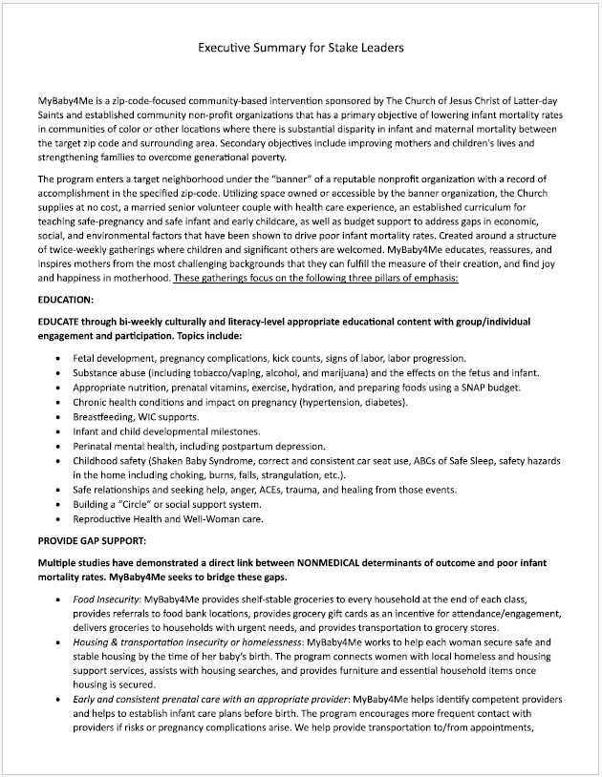
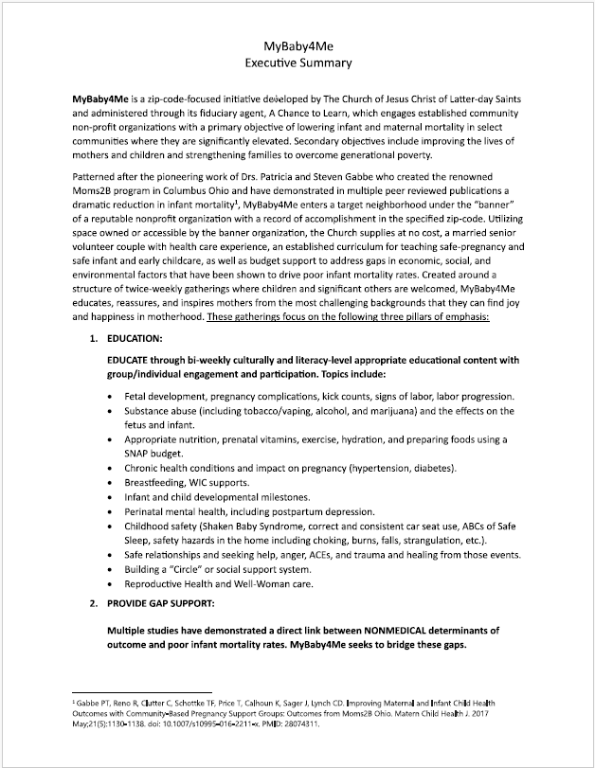
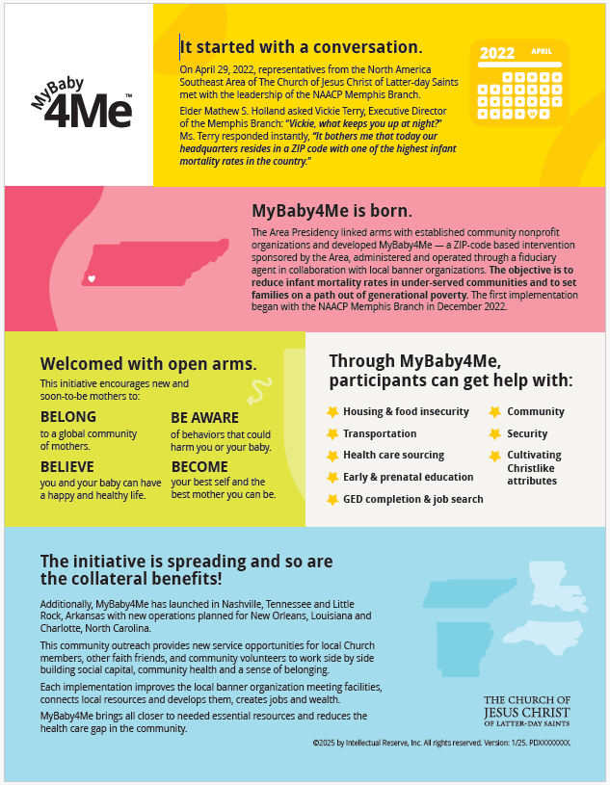
Appendix 1: Executive Summary for Priesthood Leaders

Slide 44
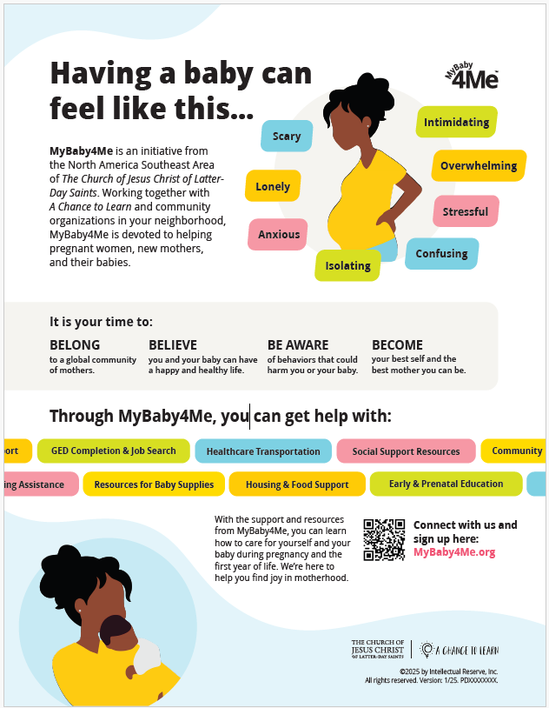
Appendix 2: Executive Summary and MyBaby4Me

Slide 45
Appendix 3: Local Banner Organization Criteria Checklist
  The MyBaby4Me initiative, with the support of the national banner organization, relies on established local banner organizations who must:
    Share the goal of improving maternal and infant
    mortality outcomes.
    Be located in a specific zip code with a history of
    high infant mortality.
    Have name recognition and a long record of service
    in the target community.
    Have credibility with the business community and local government authorities.
    Be designated by the IRS as a charitable
    501(c)(3) organization.
    Be fiscally solvent.
    Be willing to leverage their influence in the community to bring other necessary organizations to the team, including:
      Local hospitals.
      Local academic medical centers.
      The public health authority.
      Local grocers (where gift cards can be obtained).
      State or local governmental officials.
      Local business and philanthropic interests.
    Meet facility requirements, including:
      Physical location that can serve as the gathering place for MyBaby4Me activities, comfortably accommodating between 10 and 30 individuals.
      Be located in the target zip code.
      Have a commercial-grade food preparation kitchen with sufficient refrigeration capacity, or space for a new {provided} refrigerator.
      Have storage capacity for shelf-stable food items that are distributed to participants at each session.
      Have space for a locked cabinet for toys.
    Clarify that, in general, the Church will fund MyBaby4Me operations for the first 18 to 24 months.
    Clarify that after the first 12 months of operation, the national banner organization takes the lead on identifying and securing community philanthropic resources and state/federal grants that will fund the initiative in the long term.
      Existing grants may provide helpful context for authoring new grant proposals.

Slide 46
Appendix 4: Miscellaneous Commodities Checklist
  Obtain the newest version of the Bishop’s Storehouse Humanitarian Order Form from the assigned welfare/self-reliance manager. In areas without the support of a local bishop’s storehouse, plan to stock local banner facility with commodities (donated preferable to purchased).
  GROCERY BAG ESSENTIALS
    To be determined by the national banner organization
  ON-SITE MEAL PREP
    To be determined by the national banner organization

Slide 47
Appendix 5: Essential Relationships Checklist
  The area consultant, along with the national and local banner organizations, builds essential relationships in the community to achieve the desired outcomes of the MyBaby4Me initiative. These essential relationships may include:
    Hospitals—especially where mothers receiving Medicaid from
    the target zip code deliver their babies
    Academic medical centers
    Transportation providers
      Many women will not ride city buses, relying instead on transportation assistance to attend classes. Uber Health, Uber, Lyft, Yellow Cab, and other low-cost public transportation solutions are essential to the initiative.
    Health care providers
    Doulas or doula support organizations
    Lactation consultants
    Car seat/Pack and Play providers
    Pediatric dentists
    Dieticians
    Father’s advocacy organizations
    Family advocacy organizations
    Self-reliance advocacy organizations
    In general, MyBaby4Me invites organizations to participate to the extent they can, such as:
      Attending organizational and planning meetings
      Teaching approved curriculum
      Helping create connections in the community
  NOTE: No economic contribution is required or expected of the
  invited organizations

Slide 48
Appendix 6: Child Entertainment Tools Checklist
  Children are invited to a volunteer-assisted play area where their mothers can always see them. In the play area, children can have access to:
    Play mats
    Toys/dolls
    Coloring books
    Reading materials
    Puzzles
    Other activities/games
  Other considerations:
    Rather than open “play time,” intentional time allocation will assist in keeping order and helping children to have a positive and helpful experience
    Ensure that the play area includes secure storage for these items, along with sanitizing wipes or similar items to keep toys safe and clean
    Organize community volunteers from the local banner organization, local churches, medical schools, and affiliate hospitals to serve in these roles
      Members of The Church of Jesus Christ of Latter-day Saints who volunteer must be current in their children and youth protection training

Slide 49
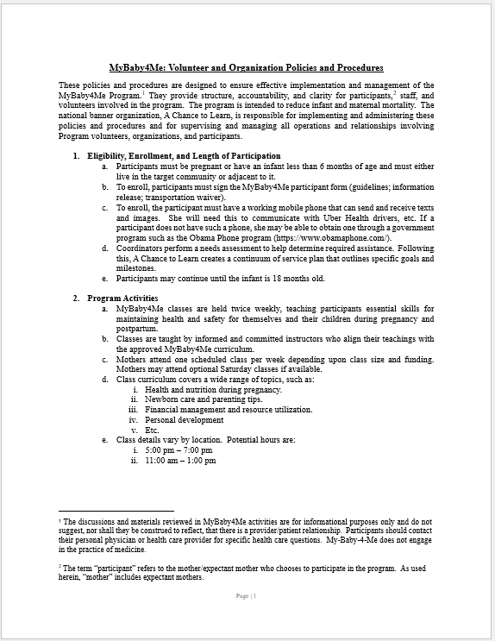
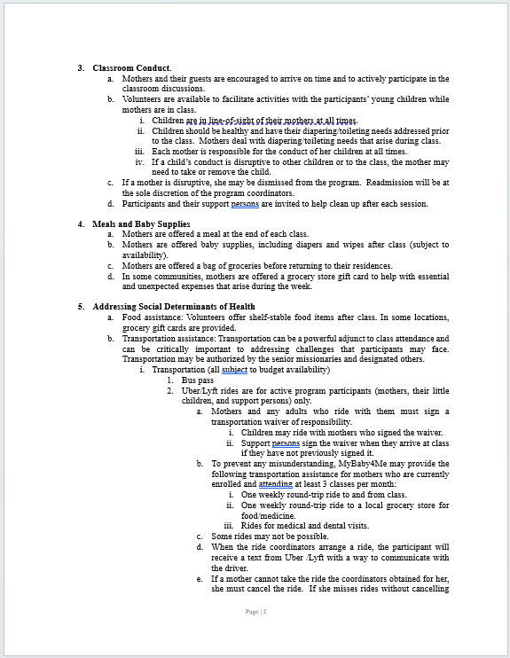
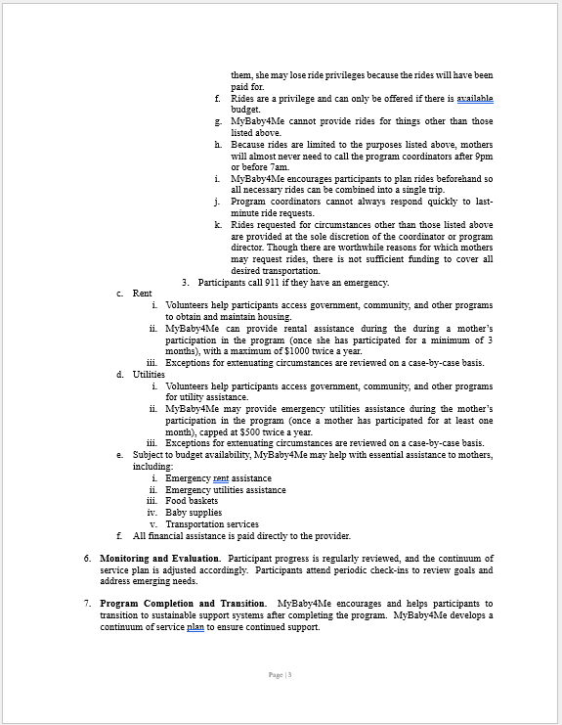
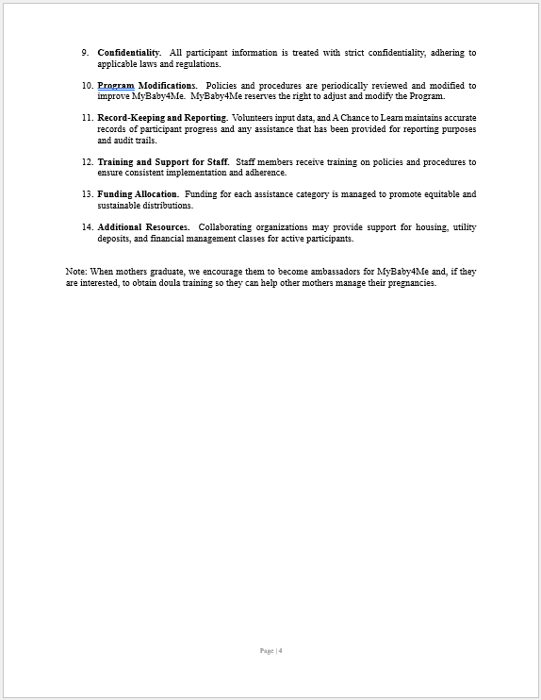
Appendix 7: MyBaby4Me Guidelines for Volunteers and Organizations
* The discussions and materials reviewed in MyBaby4Me activities are for informational purposes only and do not mean that there is a provider-patient relationship. For any specific health questions, please contact your personal physician or health care provider. MyBaby4Me does not engage in the practice of medicine.

Slide 50
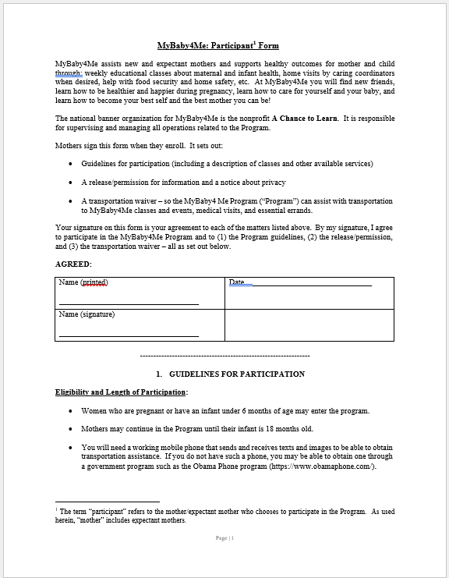
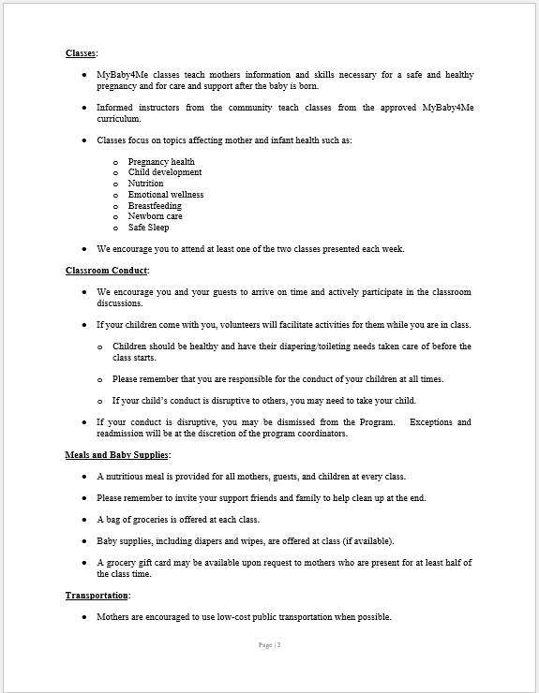
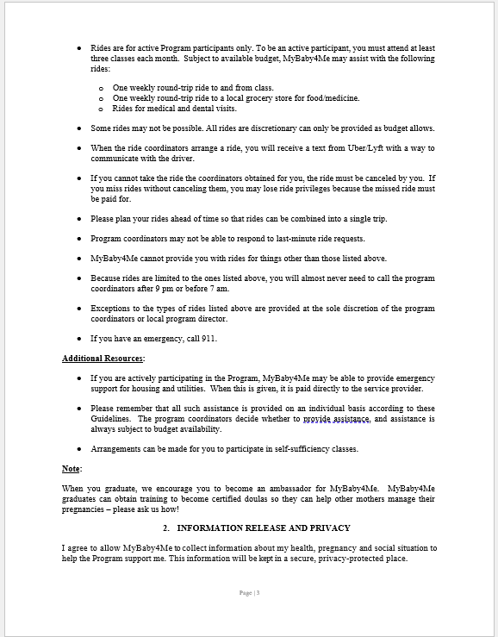
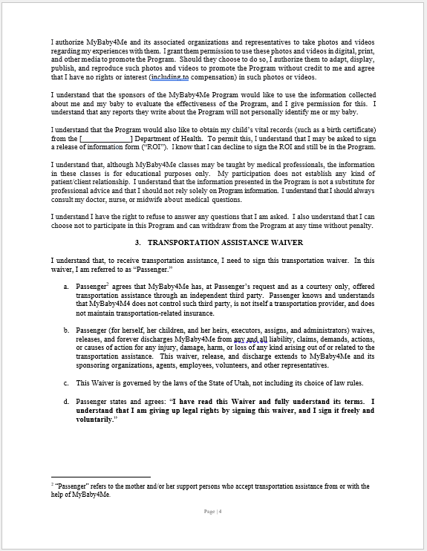
Appendix 8: MyBaby4Me Guidelines for Mothers

Slide 51
Appendix 9: MyBaby4Me Introductory
Community Presentation
    The area consultant and the national banner organization hold an introductory meeting with key participants from the potential local banner organization and other community stakeholders
    During this meeting, the area consultant and the national banner organization present an introduction of the MyBaby4Me initiative, including:
      A brief history of the initiative
      Its framework
      Its operational plan
    Use the following template to prepare a
    PowerPoint presentation for the meeting:
    MyBaby4Me Introduction Presentation Draft.pptx

Slide 52
Appendix 10: Full-Time Missionary Couple Checklist
    Place MyBaby4Me opportunities on the
    senior missionary website
      Contact Clayton Toone (801-240-6806) at Senior Missionary Services. He will put the new MyBaby4Me complement opportunity on the
      senior missionary website.
    Recruit potential missionaries
      The area MyBaby4Me consultant identifies couples who want to serve senior missions as MyBaby4Me infant and maternal care specialists.
      The area MyBaby4Me consultant reaches out to identified couples through the website and referral.
      The couples select the MyBaby4Me assignment they desire on the
      senior missionary website.
      The area MyBaby4Me consultant then contacts Senior Missionary Services to indicate that the couple desires to serve in a particular MyBaby4Me assignment.
        Fill out the "Senior Missionary Request" form and submit it to Senior Missionary Services at: SeniorMissionaryRequest@churchofjesuschrist.org
        Inform the couple that it generally takes about 12 weeks from the time a candidate begins the application process until the call is issued.
      Couple begins pre-MTC training a month before they enter the MTC.
    Missionary business cards
      Area consultant submits missionary names and local banner organization address to publishing services manager, who orders and bills to the area.
    Lodging
      Reach out to the host mission office to obtain housing. Host mission housing coordinator will arrange housing for missionaries.
      Ask local stake Relief Society presidencies to assist with finding lodging if the host mission cannot assist.
    Curriculum and syllabus review
      Senior missionaries familiarize themselves with the initiative by studying the MyBaby4Me syllabus and authorized curriculum.
      Senior missionaries study the pre-MTC MyBaby4Me training.
      Senior missionaries ensure that:
        They only share information from the public domain
        They do not enter into a provider-patient relationship
        The sisters’ circle meetings and any other MyBaby4Me-related visits do not constitute medical practice nor require state medical licensure.
      When referencing the original Ohio State University materials, the attribution “Adopted with permission from Moms2B, Ohio State University” is noted on any written or projected materials.
    Cell phone
      Missionaries receive the MyBaby4Me cell phone used by the
      previous missionary couple.
      For new locations the area welfare self-reliance manager (AWSRM) procures a new smartphone, which ideally would have the new location’s area code, if possible.
        The cell phone should be confirmed operational before releasing any marketing materials or public service announcements at least one week before the community press conference and neighborhood canvas.

Slide 53
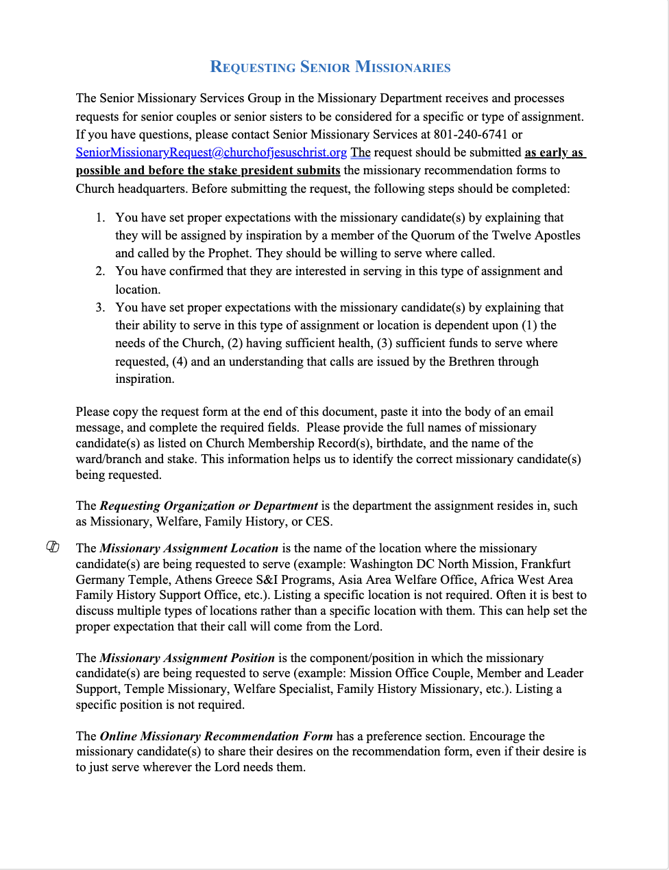
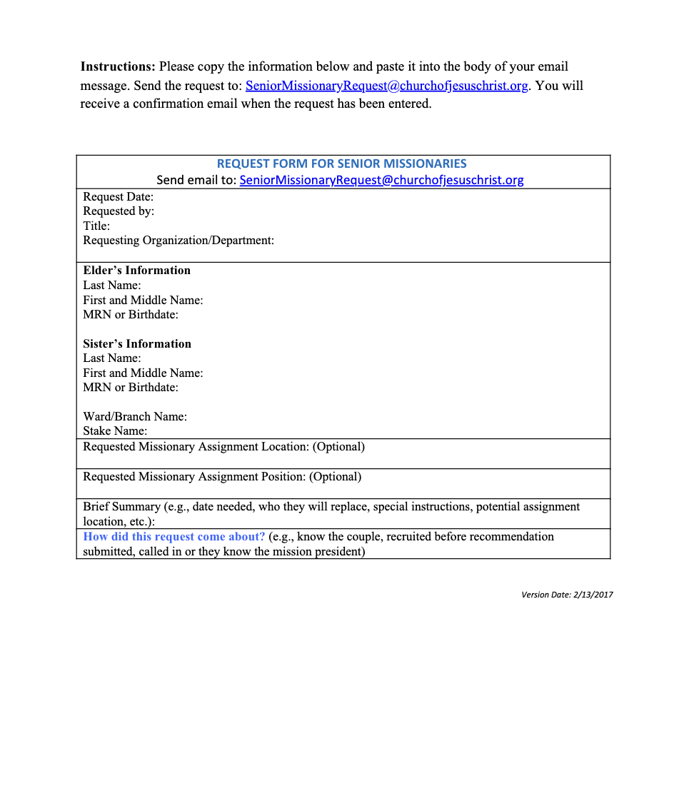
Appendix 10: Full-Time Missionary Couple Checklist Cont.

Slide 54
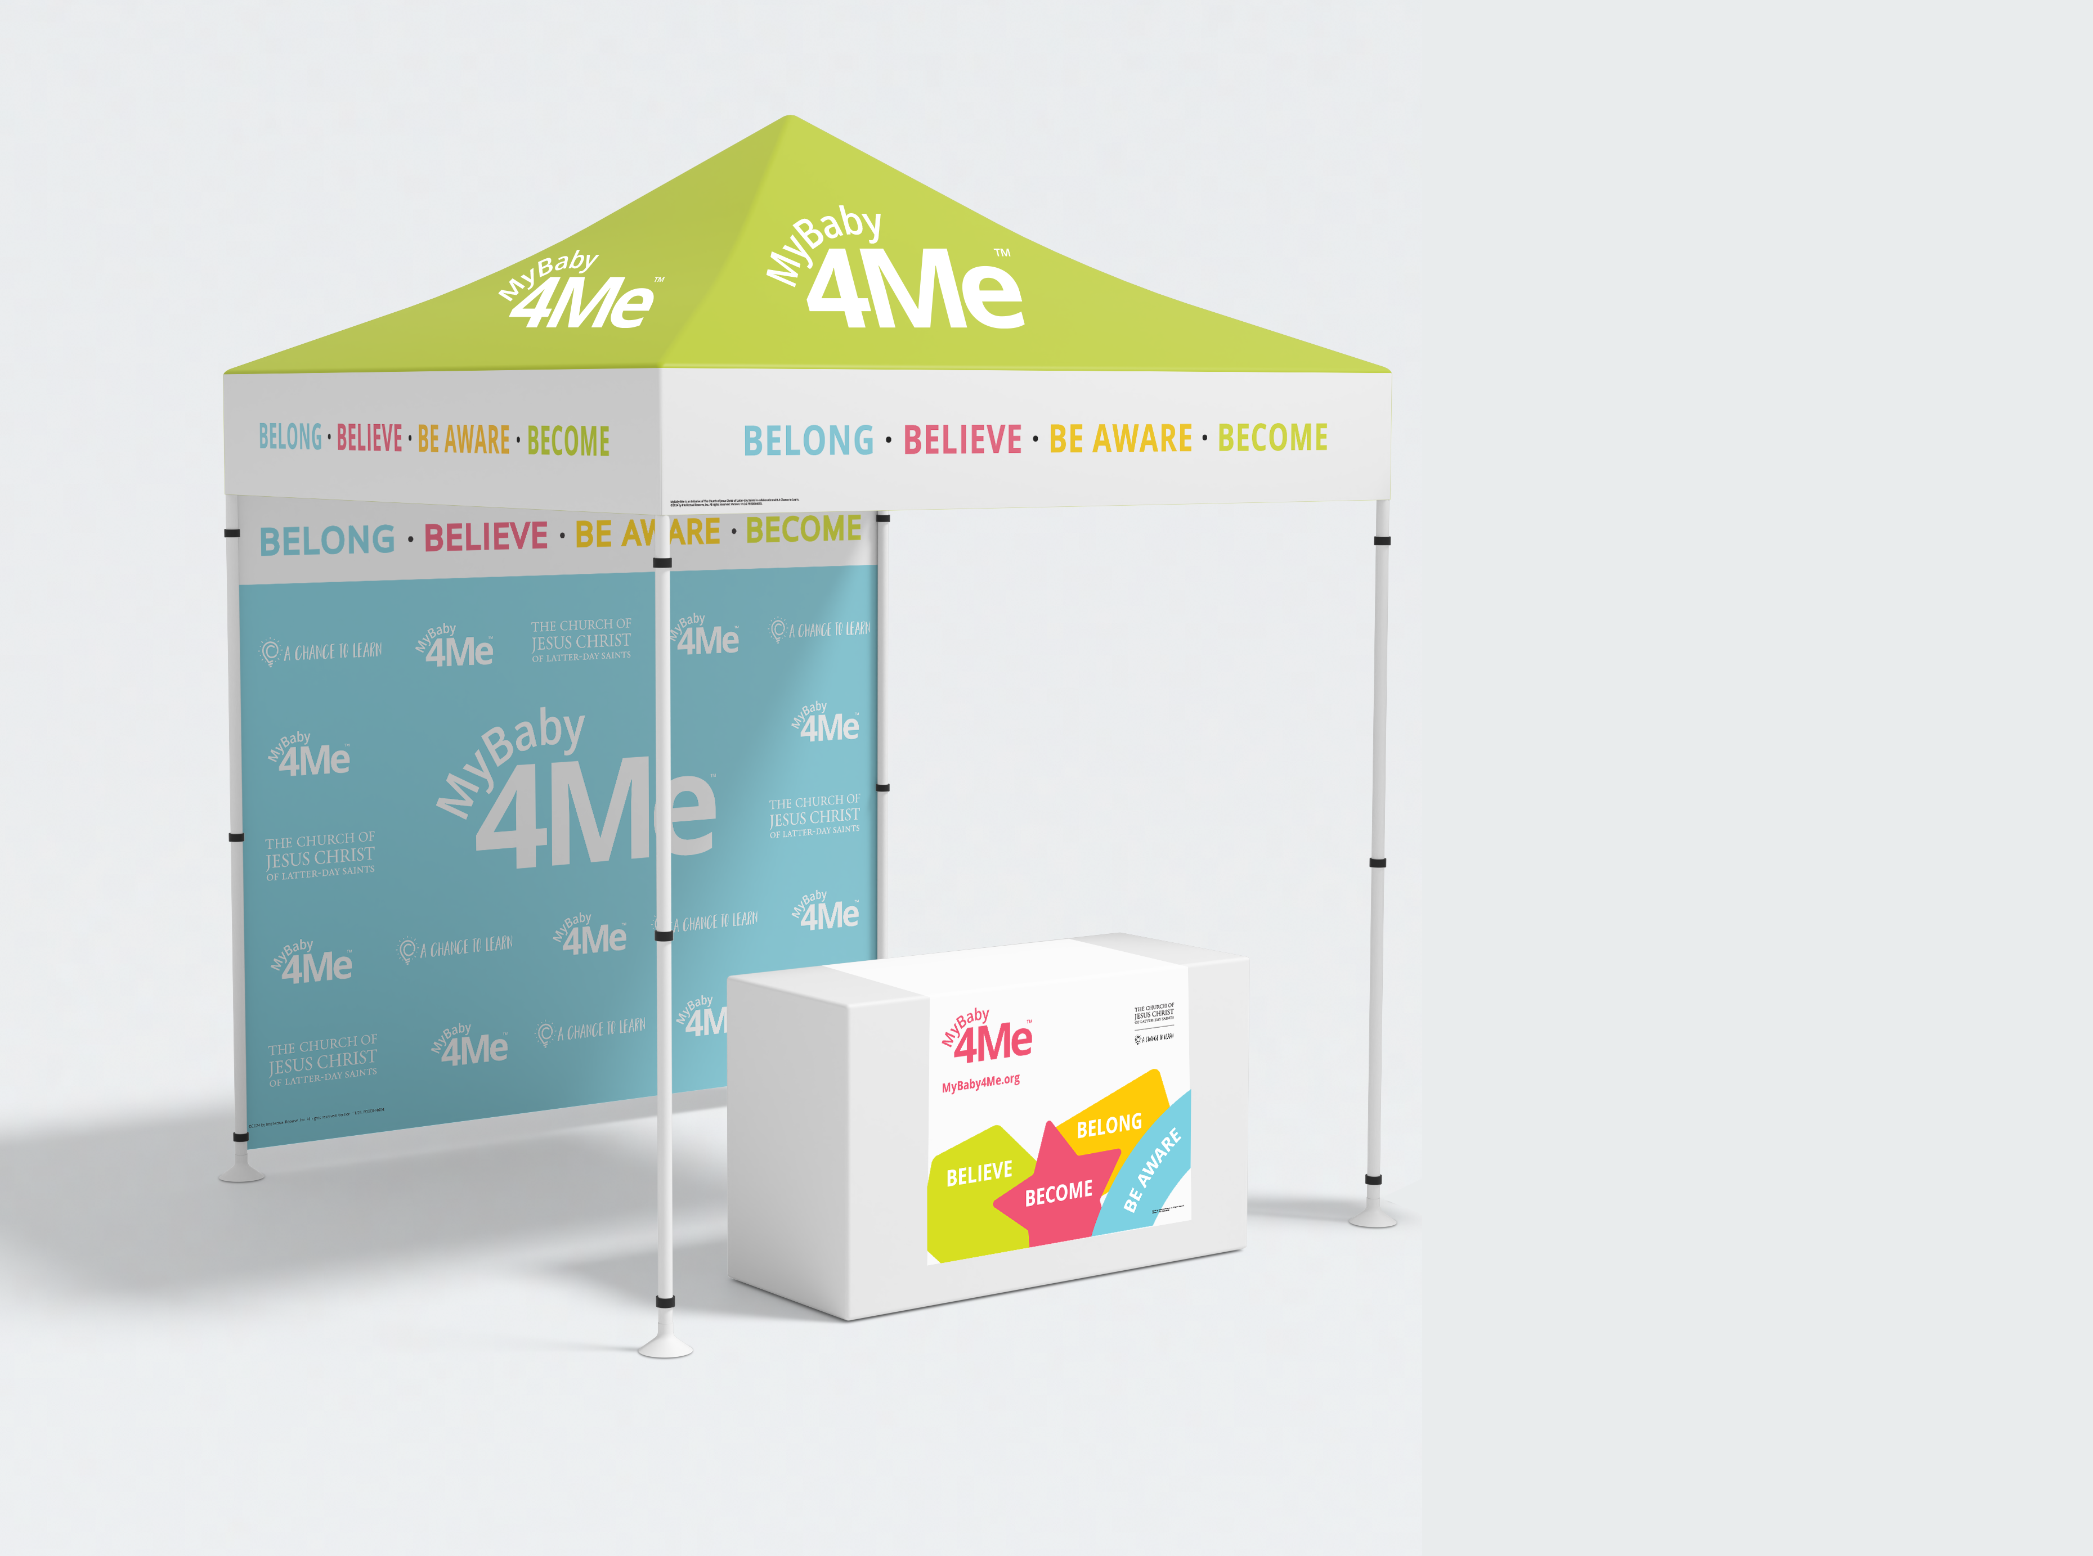

Appendix 11: Marketing Kit
    2 banner stand
    2 feather flags
    1 table runner
    1 institutional brochure
    1 infographic
    4 laminated posters
    1 canopy
    1 step and repeat backwall

Slide 55
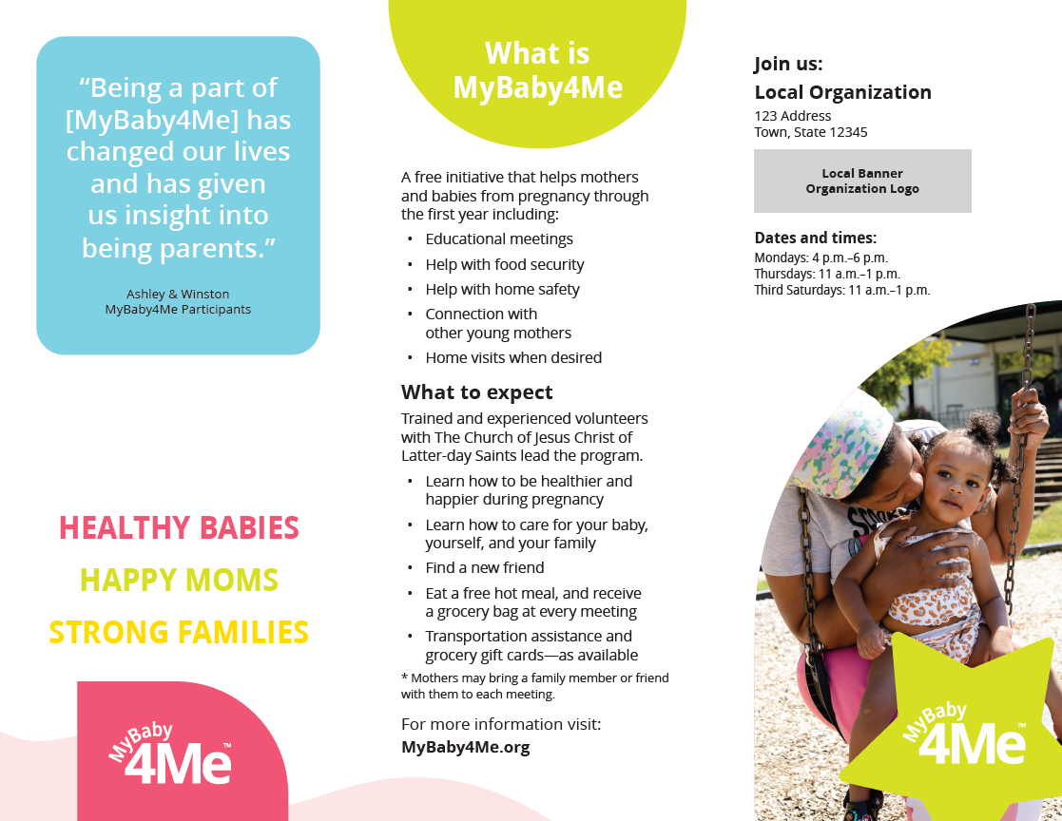
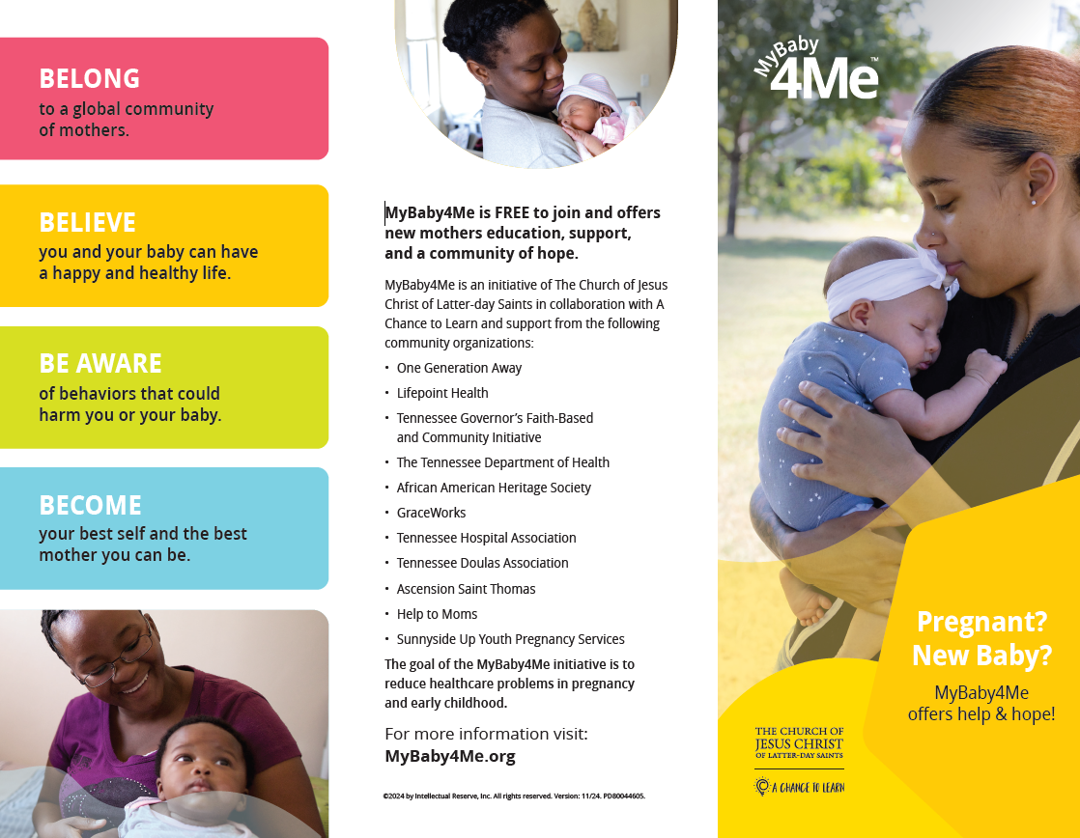
Appendix 11: Marketing Kit

Slide 56
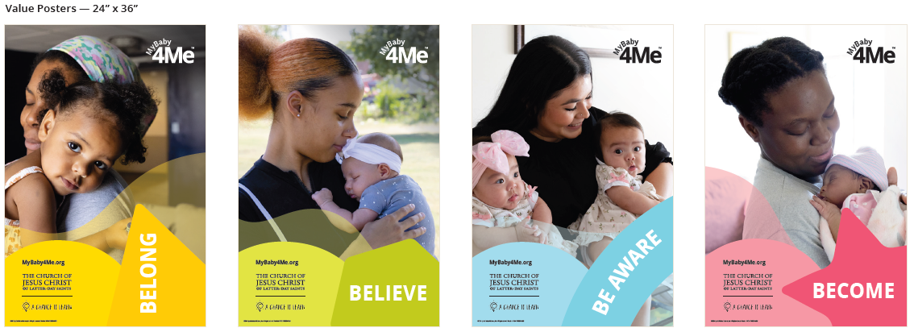
Appendix 11: Marketing Kit

Slide 57


Appendix 11: Marketing Kit

Slide 58
Appendix 12: Launch Marketing/Communication Plan
    Marketing plan
      MyBaby4Me brochures, banners, flags, tablecloths, one-page summaries, and other print materials available in PDF format can be shared with potential collaborating organizations to drive interest in the initiative.
        Please work with the publishing services manager and area communications director to order these approximately
        60 to 90 days before launch.
      Plan to canvas the targeted neighborhood in conjunction with a formal press conference 3 to 4 weeks before the initiative launch.
        Each household in the zip code or targeted neighborhood(s) receives a copy of the brochure.
        Canvasing volunteers encourage people to attend by briefly explaining what the initiative offers.
      The local banner organization can contact local media to ask them to highlight the initiative with print, web, and television news stories.
      Posters include names of collaborating organizations.
        A list of the organizations is submitted no later than 60 days before launch so posters can be created.
      Marketing materials and one-page documents:
        Maps, phone numbers, organizations names, and the host city for each new location are inserted into the pamphlet templates created for MyBaby4Me.
        When pamphlet updates are completed, they should be printed locally to avoid unnecessary shipping costs and logistical issues.
        The local communications director should be able to assist with locating a suitable printer.
        When a printer has been identified, printing costs can be covered by the area publishing budget.
        Work with your publishing services manager for assistance
        with these costs.
        One-page documents that summarize the initiative are generic
        by design.
        Printable PDFs can be acquired from the publishing
        services manager.
        These documents can also be printed locally.
    Communication plan
      Area communications team plans a social media campaign (Facebook, Instagram, and so on) to build interest in the initiative.
      Public service announcement:
        National banner will record the public service announcement (an example can be acquired from the publishing services manager).
        Send the recording to the publishing services manager to add background music to the announcement.
        Files should be delivered no later than 30 to 45 days before
        launch in recommended formats such as 16 or 24-bit audio and 128kbs .mp3 or .wav files.
        The local communication director will ensure that the public service announcement is run in the designated area during the first weeks of initiative operation. The local banner organization may have contacts with local radio stations that broadcast in the target community.

Slide 59
Appendix 13: Program Schedule
    Inform the participants that MyBaby4Me is centered on twice weekly, two-hour gatherings of expecting and recently delivered mothers from the target zip code (or neighboring areas).
    When they attend their first meeting, ask the women to complete a MyBaby4Me participant release form, release of information (ROI), and transportation waiver.
    When participants come to any MyBaby4Me meeting, ask
    them to enter basic demographic information into the MyBaby4Me data management tool owned by the national banner organization.
    A personal health inventory is obtained during each visit (appropriate to the woman's personal situation and the
    group dynamics).
      Obtain the history either early in the visit or later when the woman has developed a sense of comfort and trust with the initiative.
      Obtain key demographic and risk-factor information (in the reporting tool for the database).
      Solicit and document information about potential gaps in support.
      Track aid rendered, including meals, grocery and grocery card support, transportation, and housing assistance.
      Track pregnancy outcome and the infant’s first year of life so these details can be easily viewed at any time.
    Begin each meeting with the women, the instructors,
    and others sitting in a circle.
      Children are invited to a volunteer-assisted play area where their mothers can always see them (appendix 8).
    While the children are being entertained, senior missionaries or guest faculty lead discussions on a selected curriculum topic.
  MyBaby4Me Revolving Curriculum
    Encourage women to ask questions, express their concerns, and share with one another.
    Key safe pregnancy principles are repeatedly taught and emphasized.
    The intent of the initiative is to expose every woman to the entire curriculum at least twice during her pregnancy and then again during the first year of their newborn’s life.

Slide 60
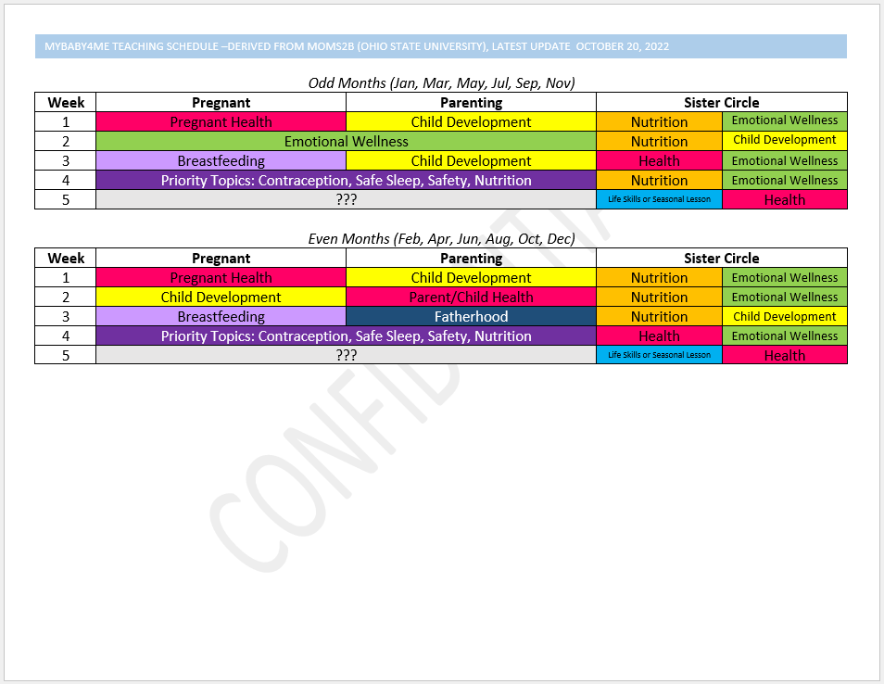
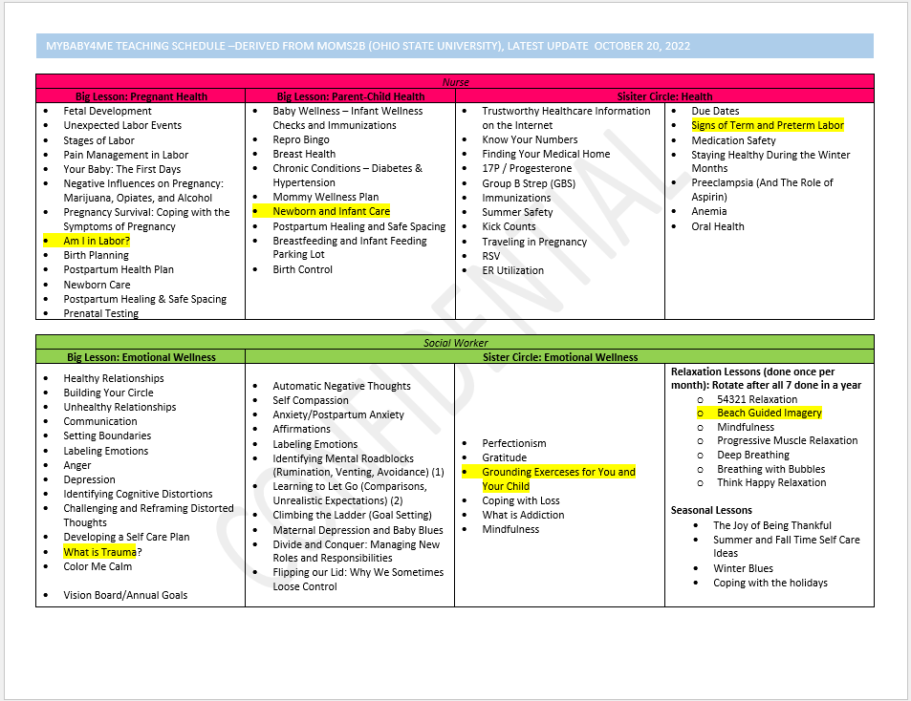
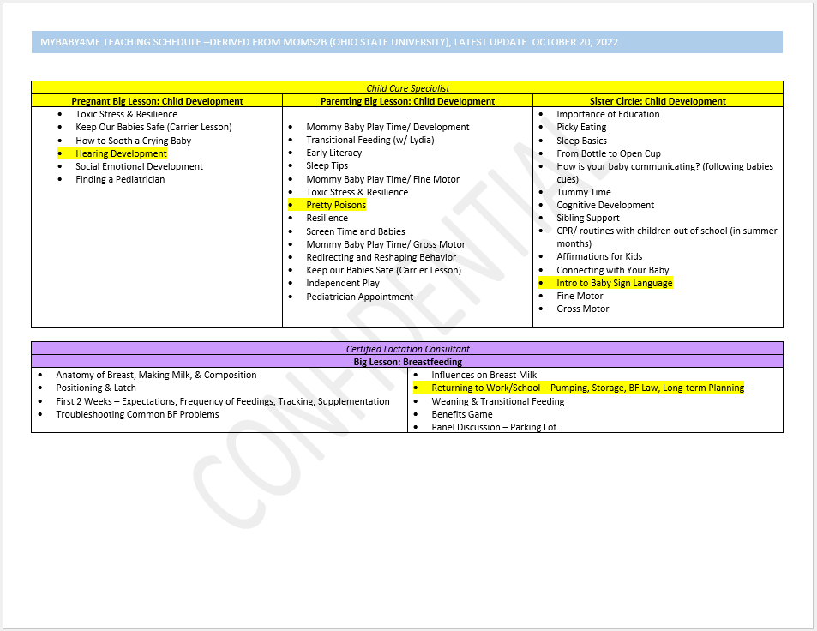
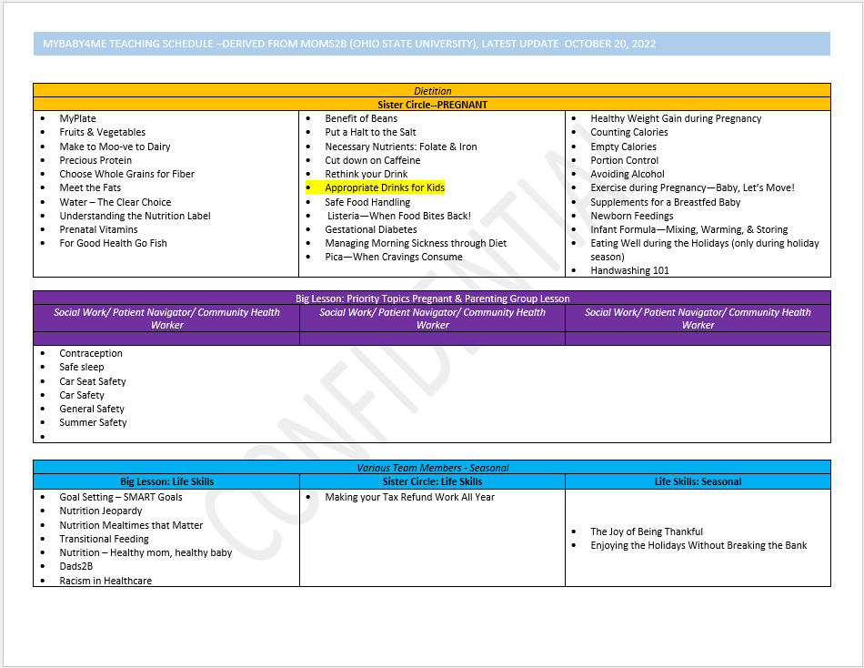
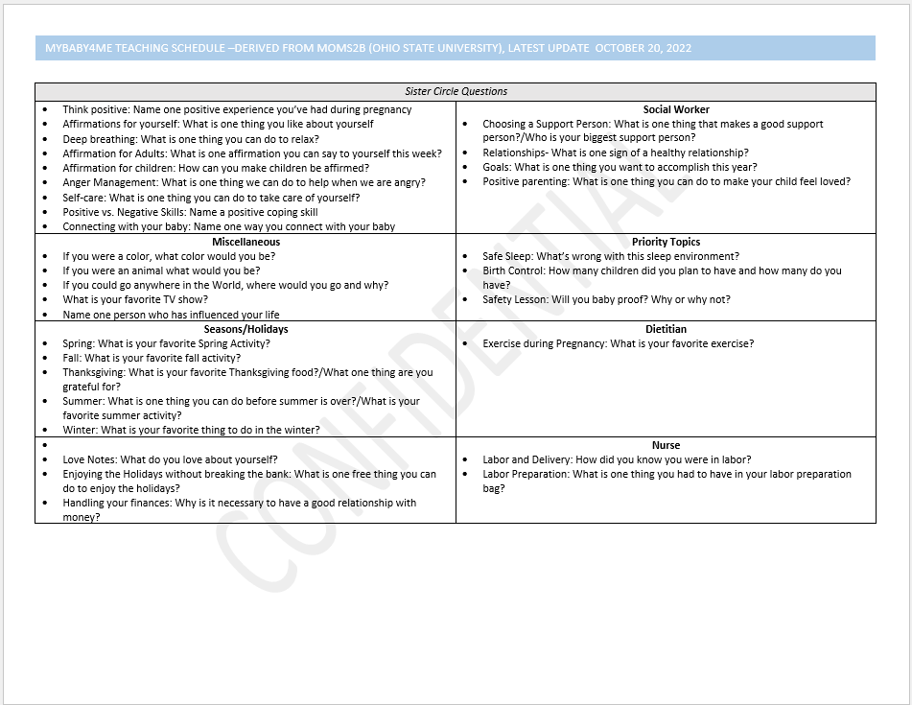
Appendix 13: Program Schedule

Slide 61
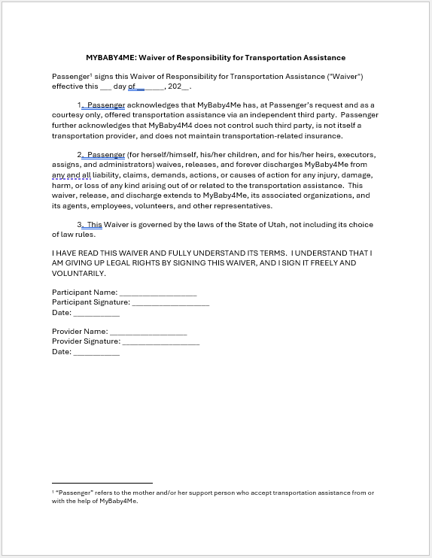
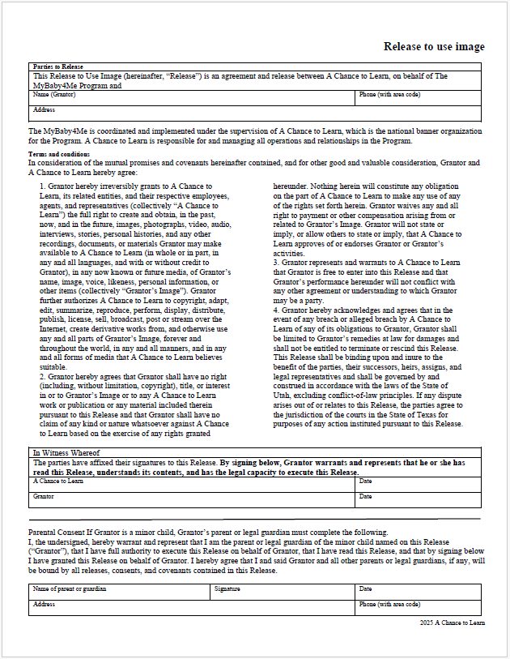
Appendix 14: Release to use Image and
Transportation Waiver Forms for Nonparticipants

Slide 62
Appendix 15: Sustainable Funding Sources
    The Church of Jesus Christ of Latter-day Saints Provides (through the national banner organization) funding for 18 to 24
    months of operation
    The national banner organization, in conjunction with Church assistance, seeks local/city/county/state/federal grant funding for an additional 3 to 5 years
    The national banner organization, in conjunction with Church assistance, seeks philanthropic endowment at the local community level
    The national banner organization, in conjunction with Church assistance, seek institutional philanthropic endowment for major initiative expansion and funding in perpetuity

Slide 63
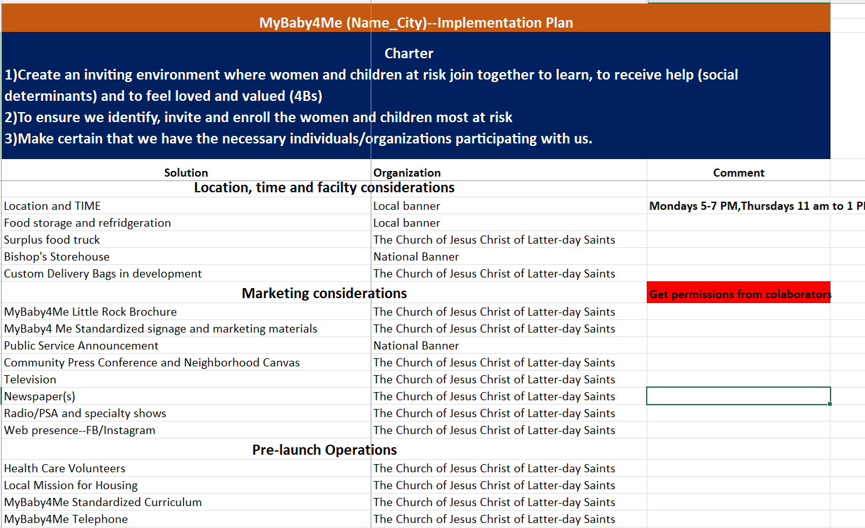
Appendix 16: Implementation Task List Sample — (Use Template)

